Slide 1
Nature.com
Antarctica meltdown could double sea level rise
Navigation tutorial

Slide 2
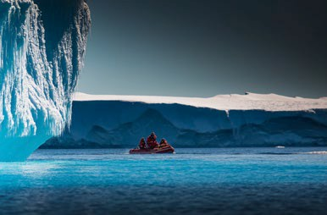
Nature.com is home to Nature and Nature Portfolio journals. We publish not only primary research but also reviews, critical comment, news and analysis.
1
The story behind the image
Antarctica meltdown could double sea level rise
Researchers at Pennsylvania State University have been considering how quickly a glacial ice melt in Antarctica would raise sea levels. By updating models with new discoveries and comparing them with past sea-level rise events they predict that a melting Antarctica could raise oceans by more than 3 feet by the end of the century if greenhouse gas emissions continued unabated, roughly doubling previous total sea- level rise estimates. Rising seas could put many of the world’s coastlines underwater or at risk of flooding and storm surges.
This guide will help you navigate the homepage as well as use our search and registration functionality.

Slide 3
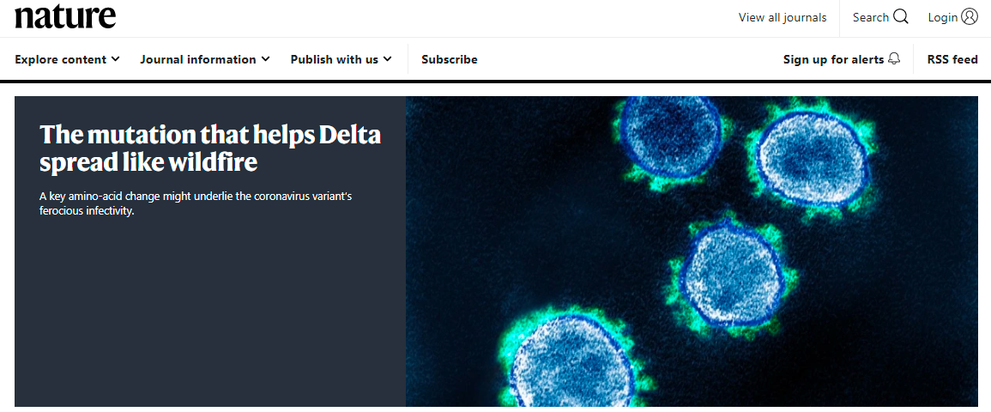
Visit www.nature.com
2
Find significant research, browse related content, manage personal settings
(Some users may see a slightly different layout)
Drop down for quick links to popular pages
All types of subscription options
Browse all Nature Portfolio journals
Register, and access your nature.com account
Search to find the content you need
Breaking news stories from the global scientific agenda are published here.

Slide 4
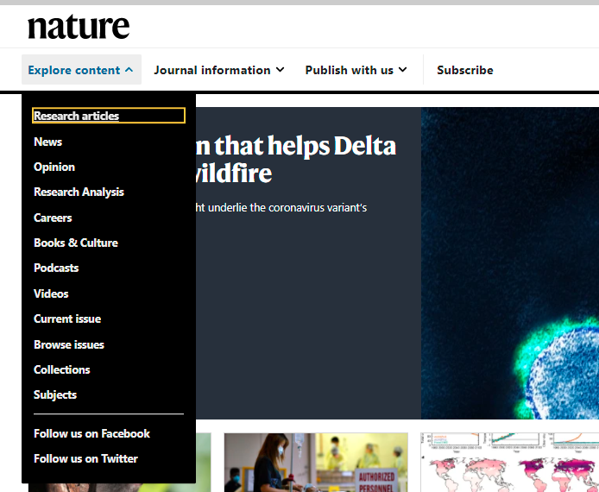
Menu
3
Use the Menu button to take shortcuts and navigate Nature and related research published by Nature Portfolio
(Some users may see a slightly different layout)
Drop down for links to popular pages
Quick links take users to specific areas
SN Presentation title / date

Slide 5
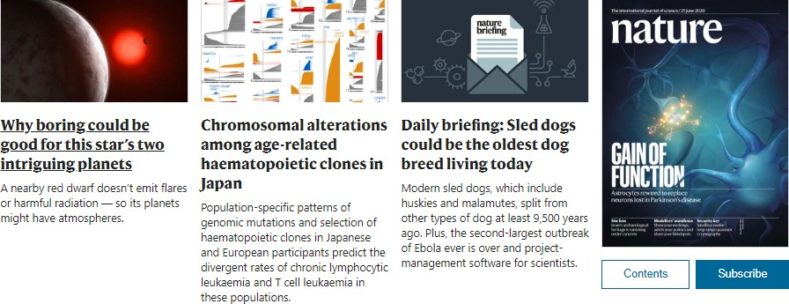
Latest Research
4
Constantly updated, the latest news and top stories from across Nature.
A selection of articles from across Nature
Clicking on the
cover will take users to the current issue of Nature

Slide 6
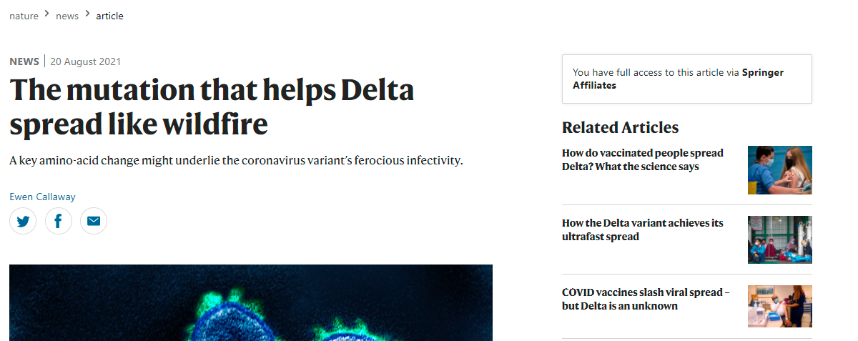
News & Comment
5
Keep up-to-date with global scientific news, analysis and commentary.
Know where you are on nature.com at anytime with the "crumb trail" along the top navigation bar.
Nature Portfolio editors both write editorial analyses and commission leading authorities to write opinions on developments in the field.

Slide 7
Trending
6
Today's most popular articles that are being shared, liked and talked about online. Altmetric tracks article citations, shares on social platforms, mentions in blogs and news outlets.
Colours indicate which media source has shared the Nature Portfolio content
Numbers indicate the amount of shares

Slide 8
Search
7
Finding the right information on nature.com is easy and intuitive
Searches can be made more specific using the "advanced" search option. See next slide for more details
Search boxes appear in the top right corner of all journal pages.

Slide 9
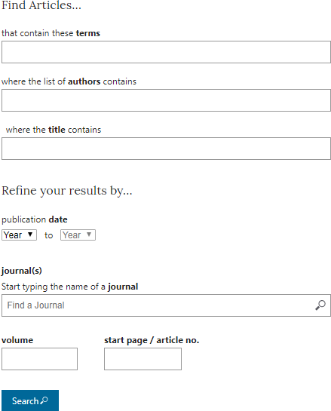
Advanced Search
8
Additional parameters to refine your search
Enter discipline
Author(s)
Article title
Year published
Nature Portfolio title

Slide 10
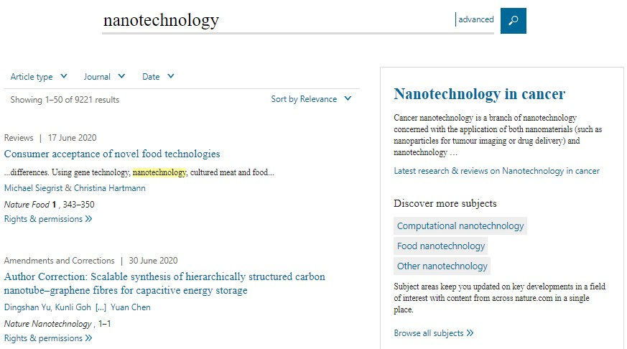
Search Results
9
Filter search results by relevance, article type, journal and date
Click the link to see the full article
Get permission to reuse Springer Nature content with RightsLink
Links to related subjects

Slide 11
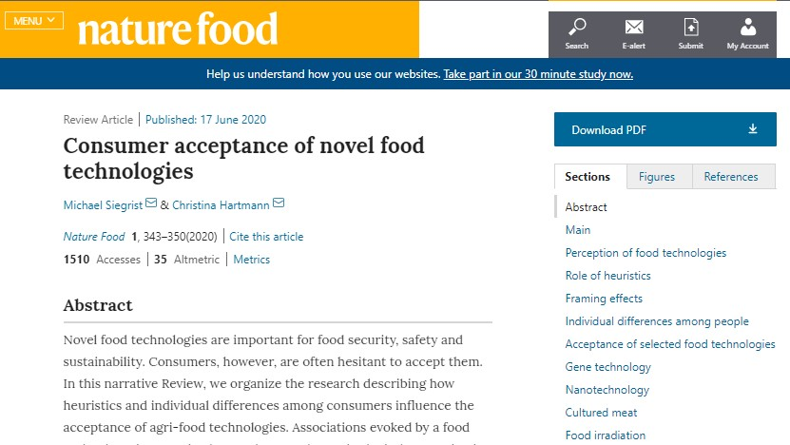
Exploring Results
10
Navigate the article by scrolling down or jump to the desired section via these links
Author(s) & Research Institution details
Use the article offline by downloading a PDF version
Article metrics (see next slide)

Slide 12
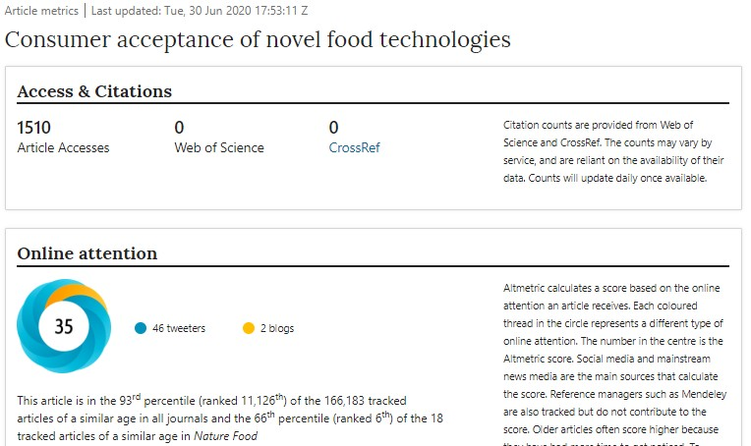
Article Metrics
11
Web of Science provides subscription-based access to multiple databases for citation data
Altmetric tracks the attention that research attracts from across all media
Amount of times the article has been accessed, or attempted to be accessed

Slide 13
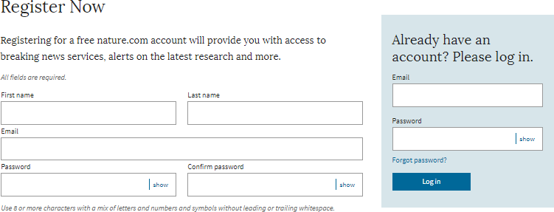
Register
12
Get the best results from nature.com by registering for your own free account.
Step 1: Click ‘Login’
Click ‘Login’
Step 2: Register for single sign-on access across nature.com
Fill out your contact information
Or log in if you're already registered

Slide 14
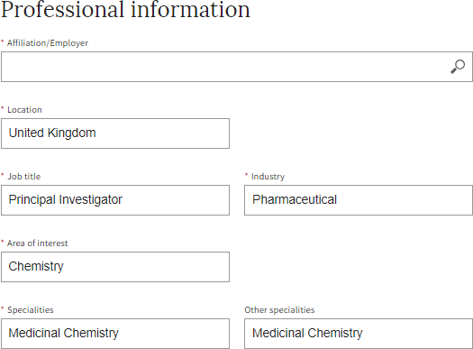
Register
13
Step 3:
Tell us a bit more about yourself so that we can suggest alerts that may be of interest.

Slide 15
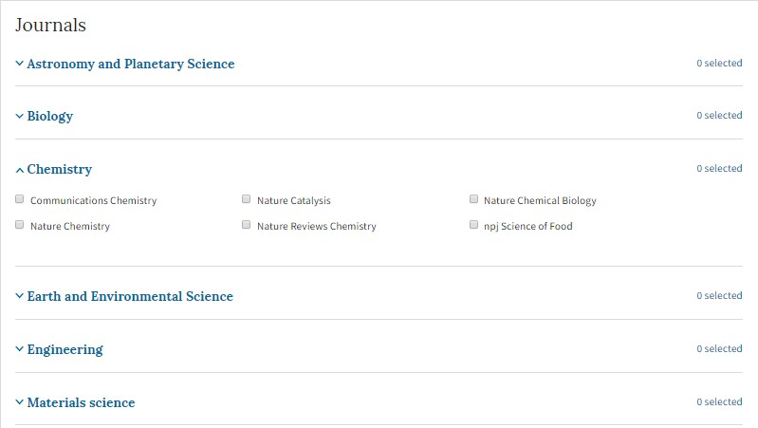
Register
14
Step 4:
Select preferred alerts and stay up-to-date with the research in your field. Preferences can be updated at any time.

Slide 16
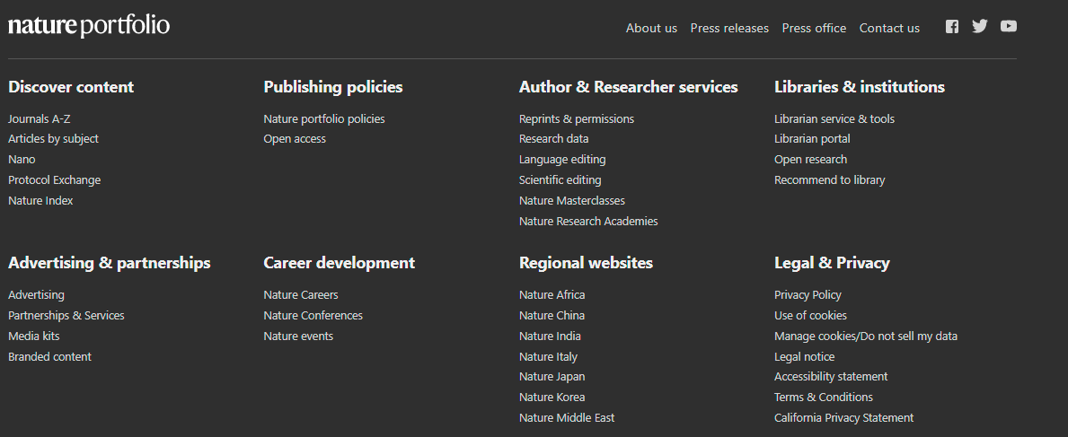
Overview
14
Lastly, for an overview of all you need to discover content, or to understand our author services, scroll down to the very end of the nature.com homepage

Slide 17
Accessibility
15
Nature.com is committed to making our website as accessible as possible to everyone, including those with visual, hearing, cognitive and motor impairments.
We're constantly working towards improving the accessibility of our website to ensure we provide equal access to all of our users.
As part of our commitment to accessibility, we ensure that our website is compatible with:
Recent versions of popular screen readers
Operating system screen magnifiers
Speech recognition software
Operating system speech packages
For more information, visit: https://www.nature.com/info/accessibility-statement

